Slide 1


Computational Engineering Mechanics
End Sem Project
Nallabothula Vamsi- BL.EN.U4AIE21086
Nallamilli S H S P Surya Vardhan Reddy-BL.EN.U4AIE21088
Mettu Siddhartha- BL.EN.U4AIE21080

Slide 2
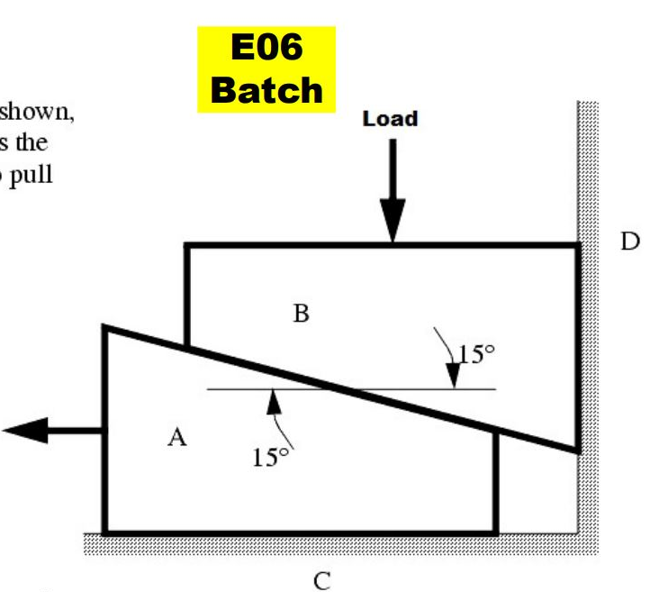
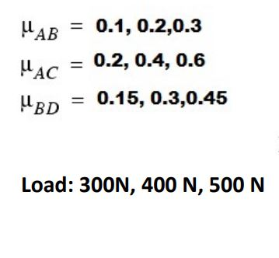
The two wedges are stacked as shown , and a load is applied. What is the minimum force P required to pull the bottom Wedge out?
Given Values :

Slide 3
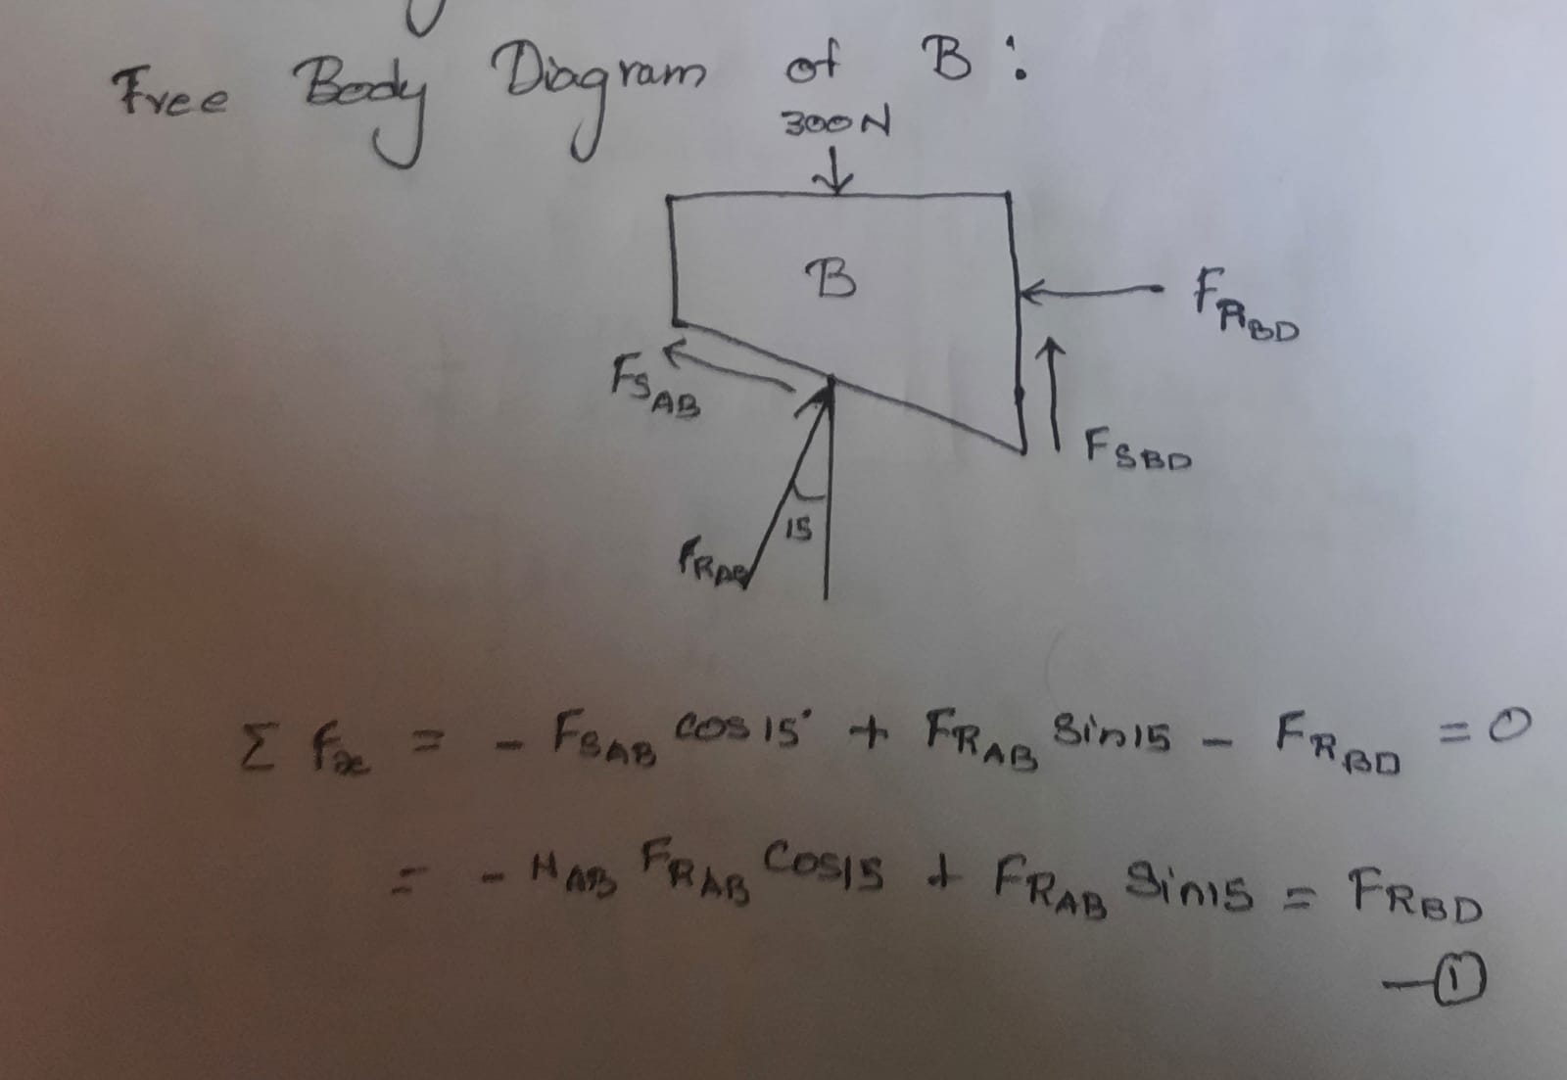
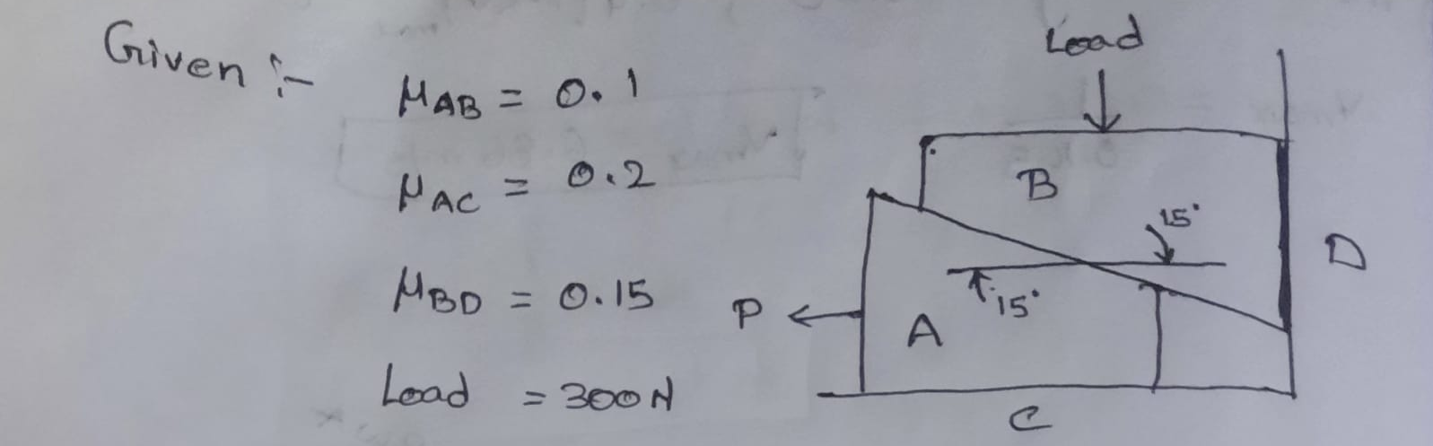
The Wedge on the top is considered as B When Bottom wedge slips out B will Push against the wall and slide down but A will try to pull it away from the wall
Case-1

Slide 4
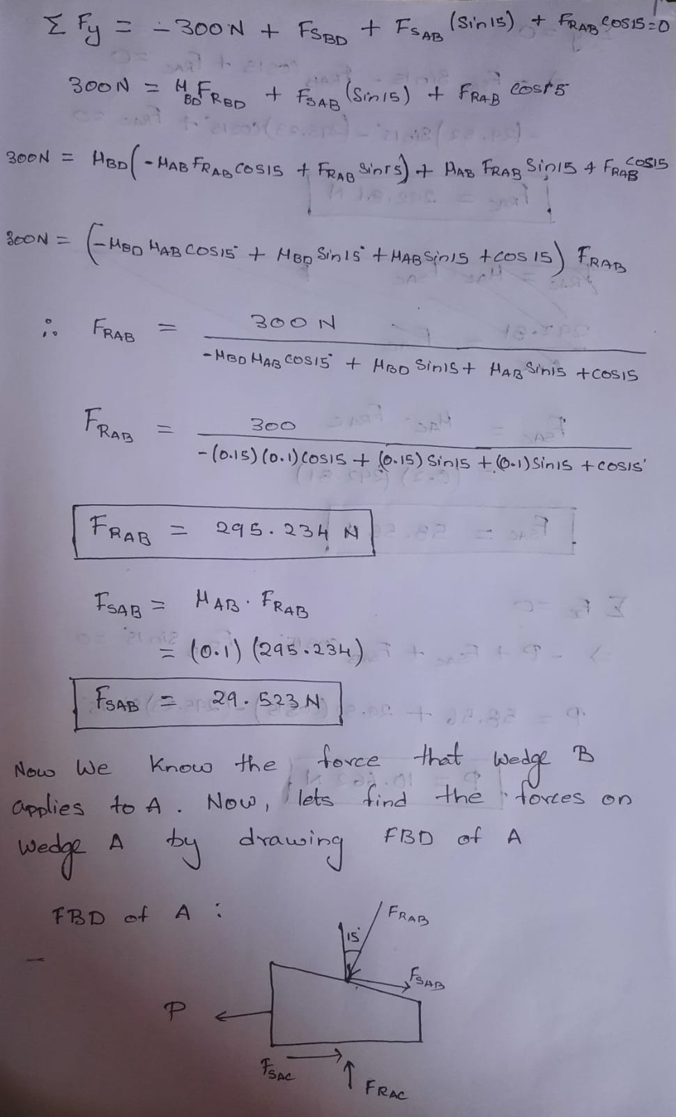
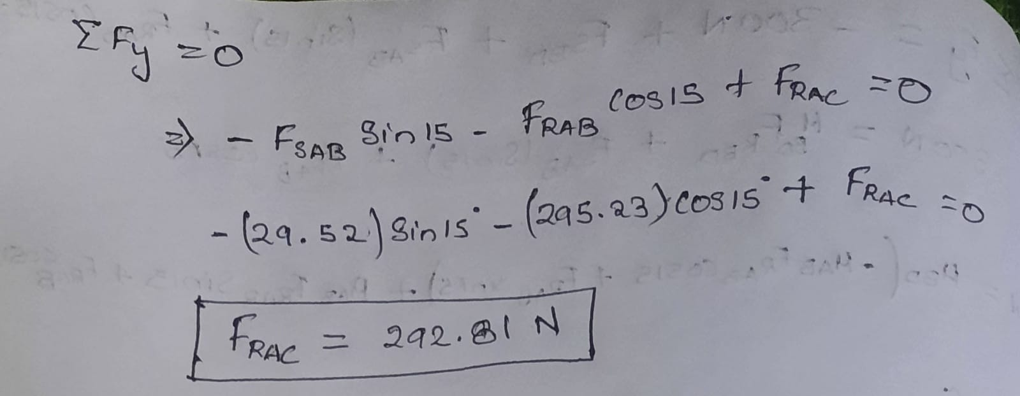
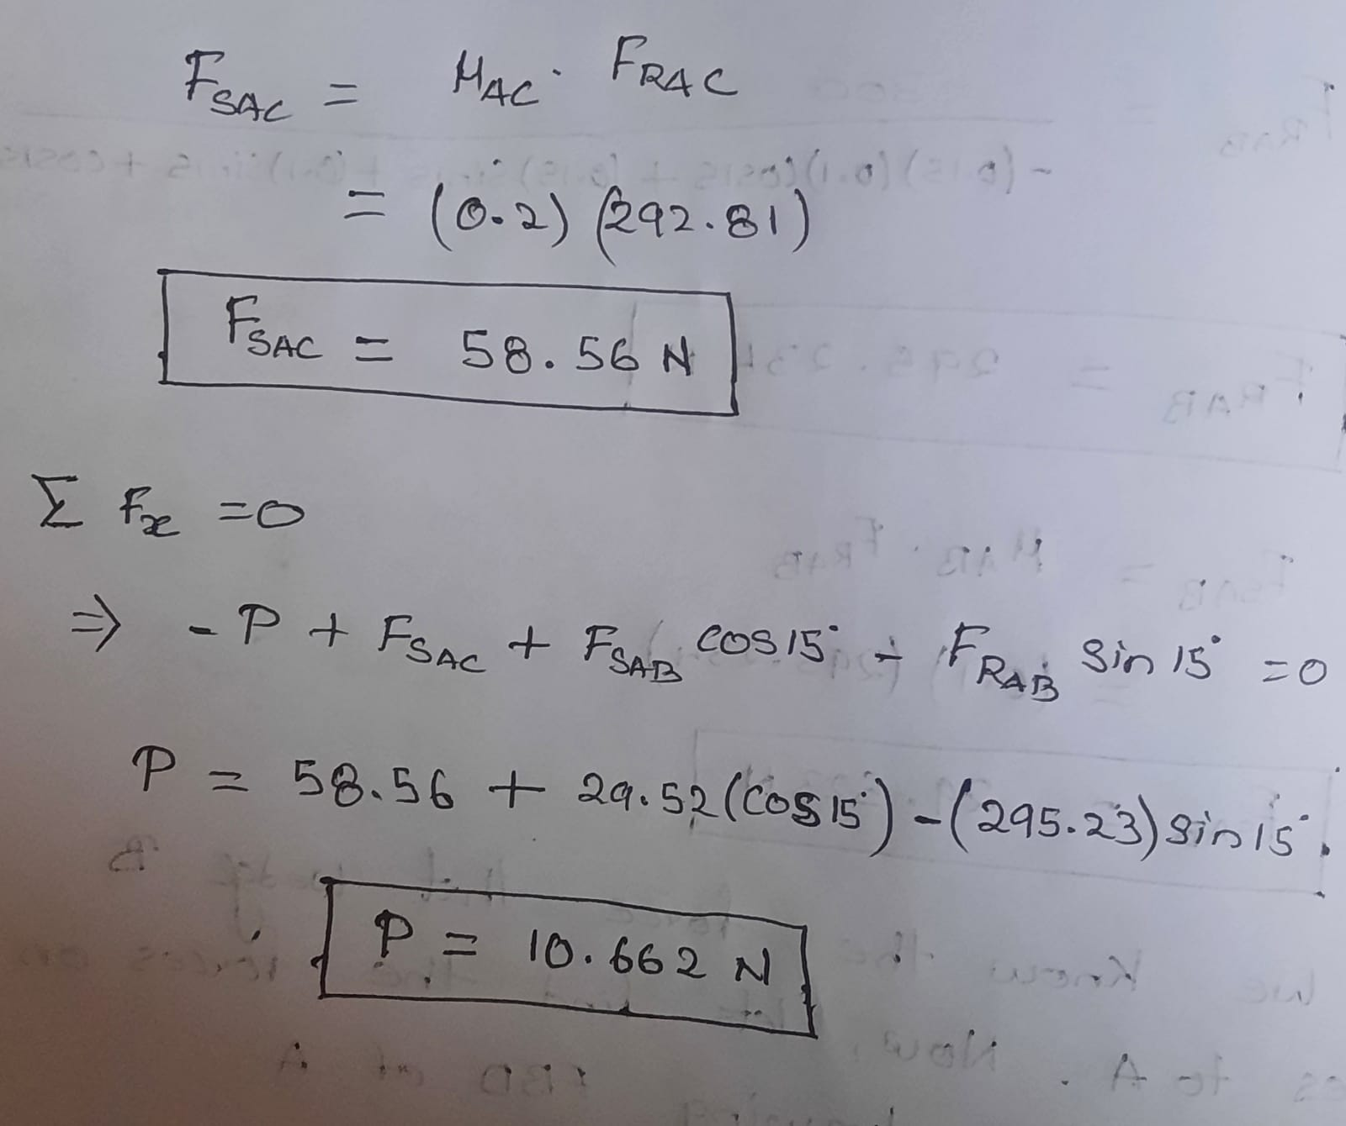

Slide 5
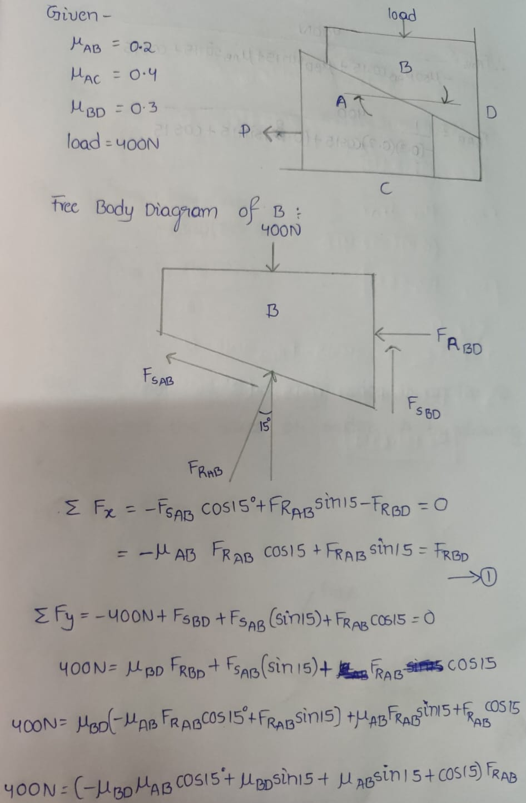
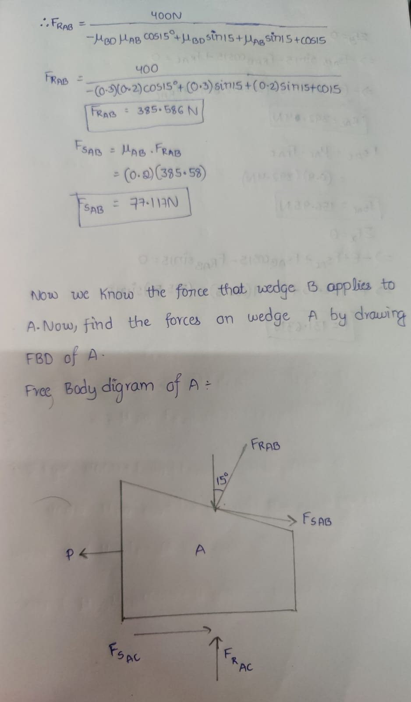
Case-2

Slide 6
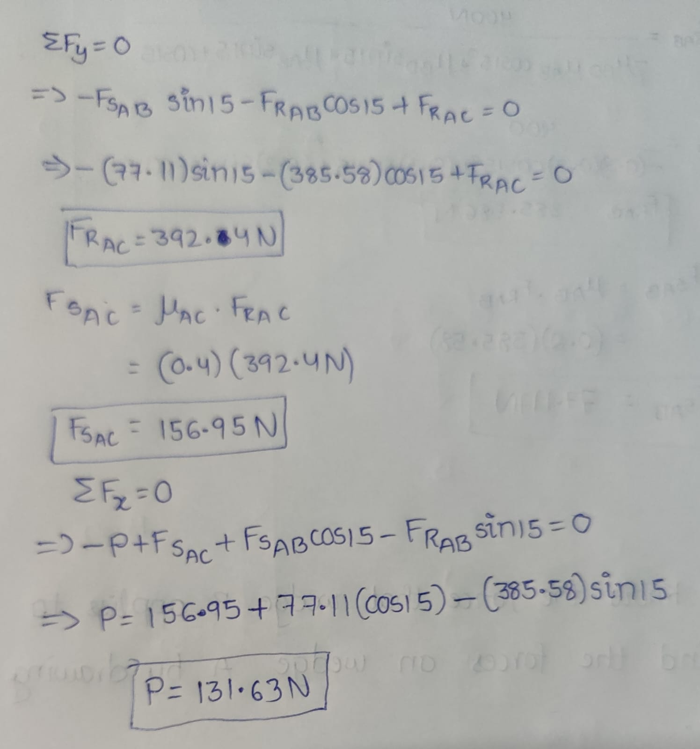

Slide 7
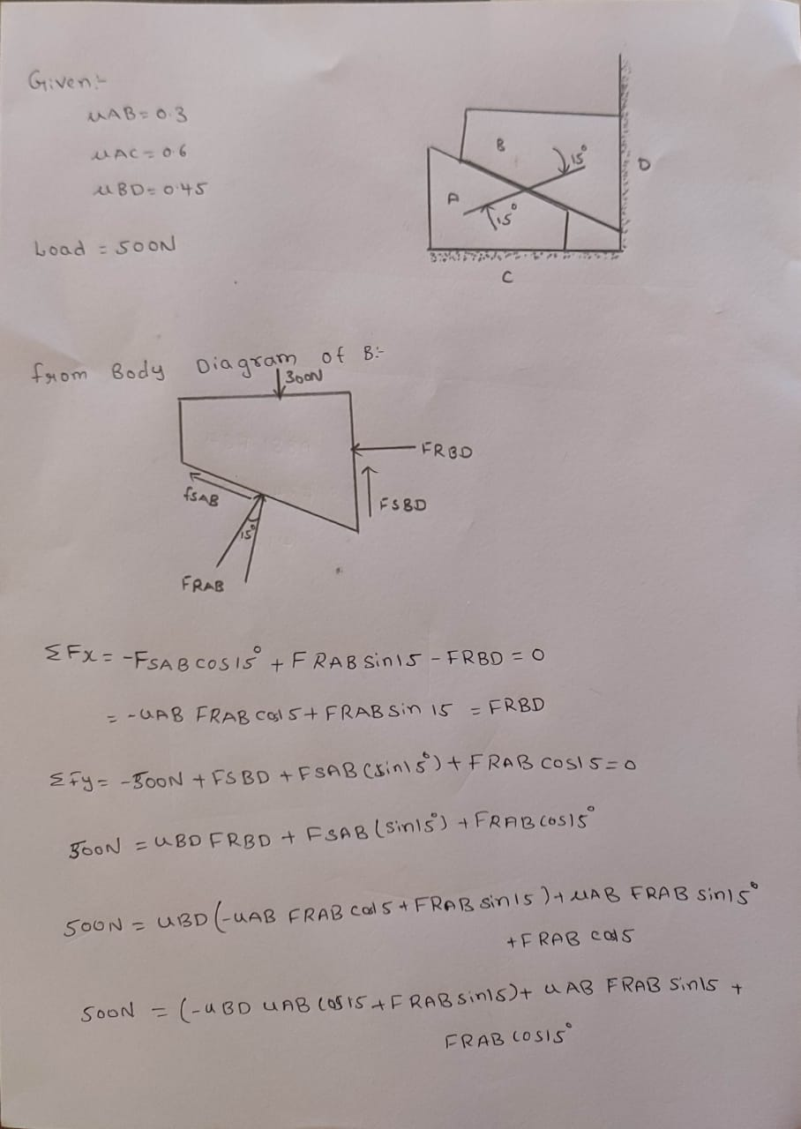
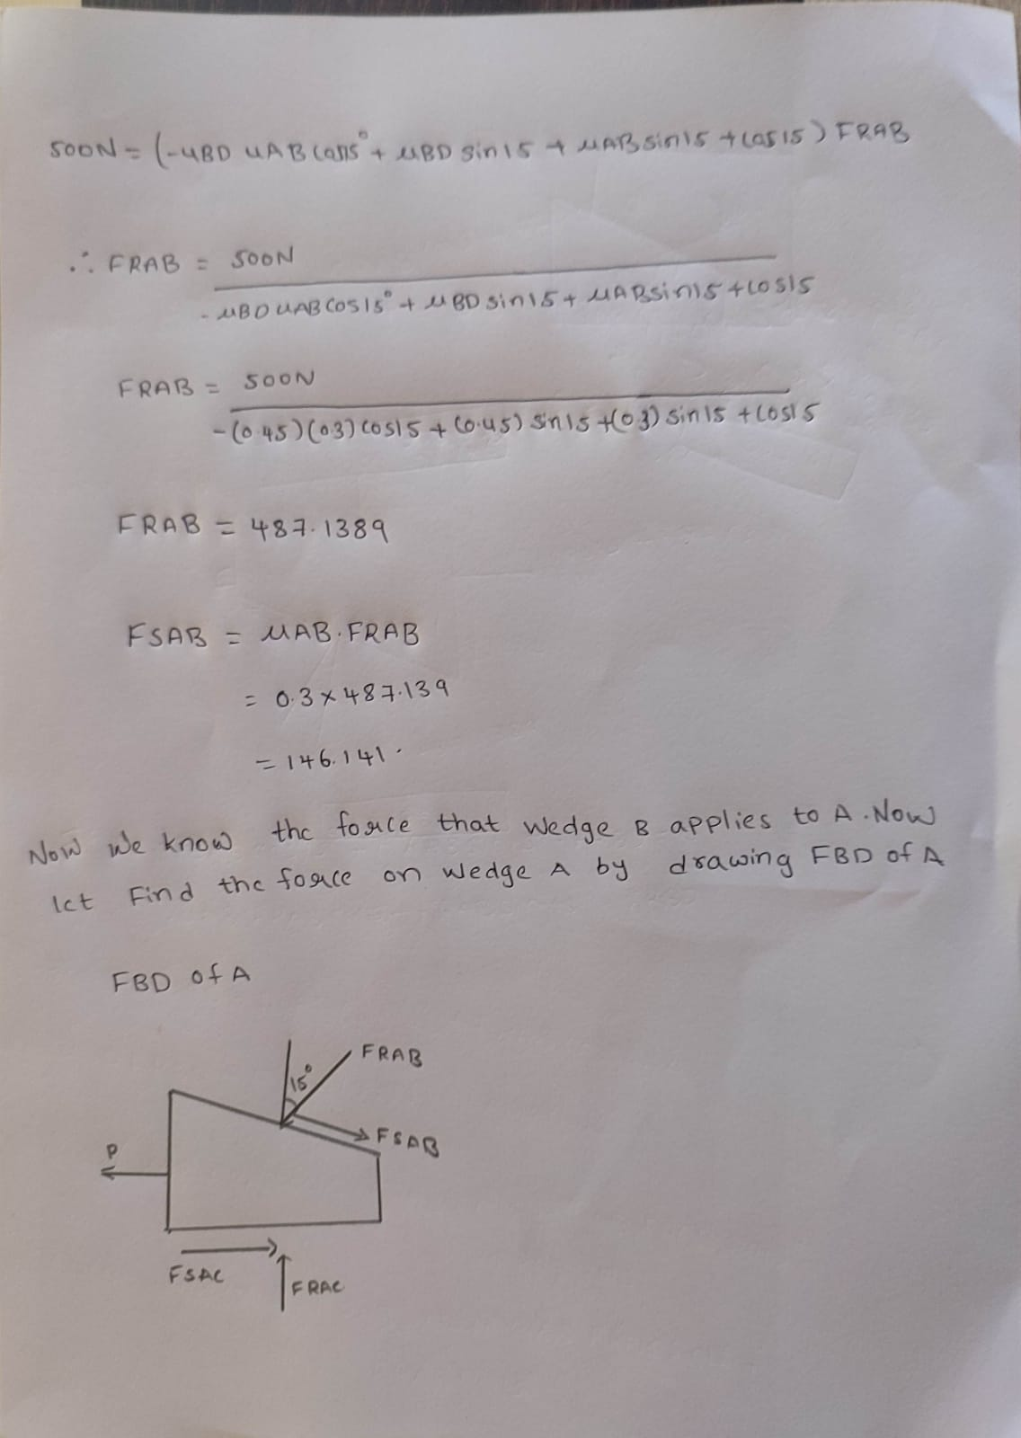
Case-3

Slide 8
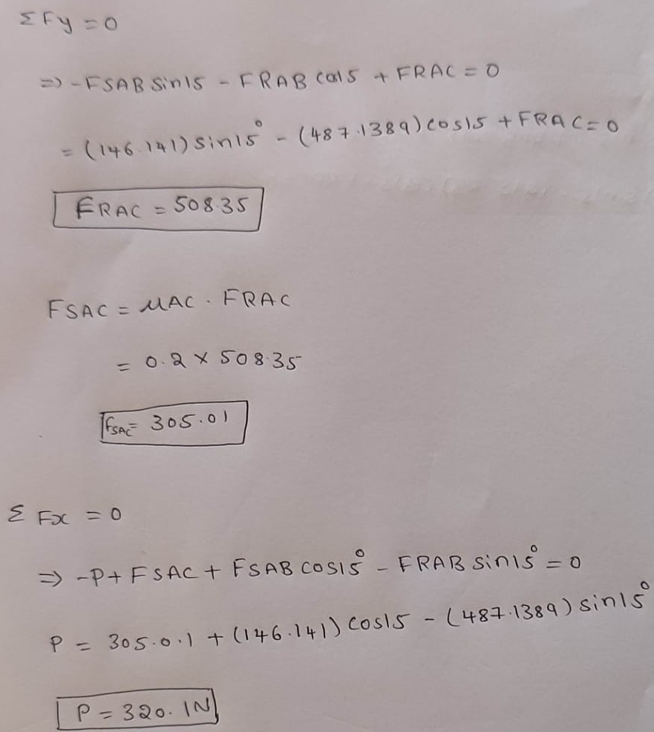

Slide 9
Thank You

